Slide 1
Mini-Project csc03a3 2023
Initials: TW
Surname: Ngobeni
Student No: 218013943

Slide 2
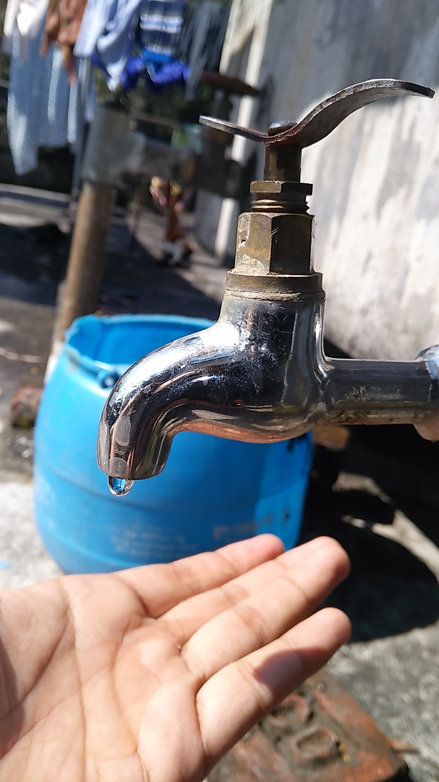
A South African socio-economical problem chosen is?
Water shortage

Slide 3
PROBLEM DESCRIPTION:
Water shortage refers to the insufficient availability of fresh-water resources to meet the standard water demand. It can be caused by factors like drought, climate and change, excessive water consumption, population growth, outdated water infrastructure and poor management of water resources.

Slide 4
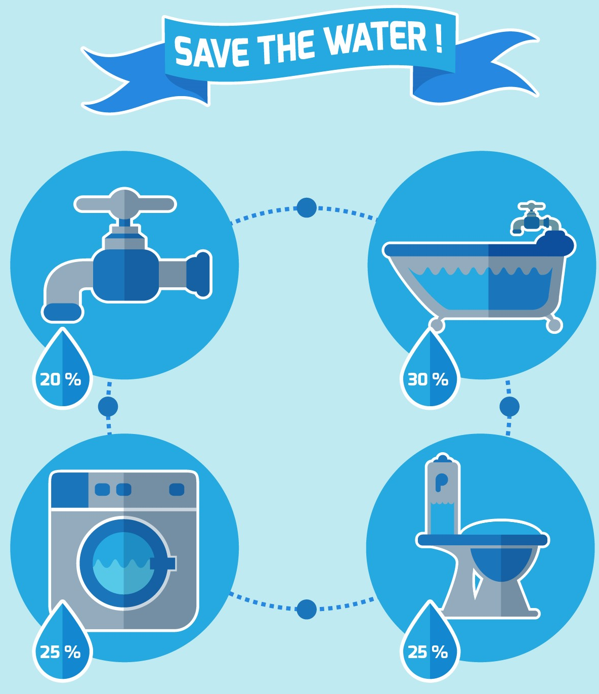

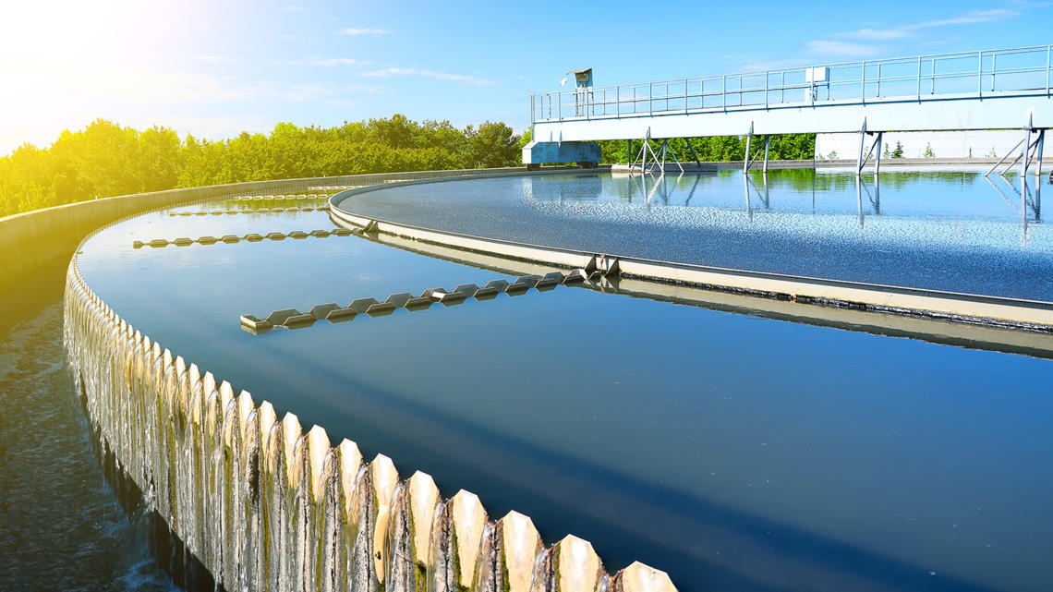
SOME OF THE CORE SOLUTIONS :
One of the core solutions is to improve water management and infrastructure.
Another solution is to promote water conservation practices.
Another solution could be water recycling ,we all should adopt the water recycling process by practicing water harvesting, and other techniques.

Slide 5
WHAT OBJECTS WILL BE CONTAINED IN THE NODES?
Water sources(rivers, lakes, etc), water treatment plant, reservoirs(water infrastructure), location(population affected), demand for water, industry and agriculture.
Region(population affected), Reservoirs(water infrastructure).
WHAT IS STORED IN THE EDGES AND WHAT ROLE DOES IT PLAY IN THE SOLUTION?
Power consumption, pressure, flow rate, pipeline construction, capacity, efficiency, speed, water level, inflow rate, outflow rate, water quality, water distribution.
Capacity(Percentage full).

Slide 6
PROJECT JUSTIFICATION:
The data stored in the edges plays a critical role in solving a water shortage issue because it helps to determine how much water a specific region has throughout the system. By analyzing the data in the edges, water managers can identify inefficiencies and areas of high demand that may contribute to water shortages. And this can help to identify optimal solutions for water management and crisis response.

Slide 7
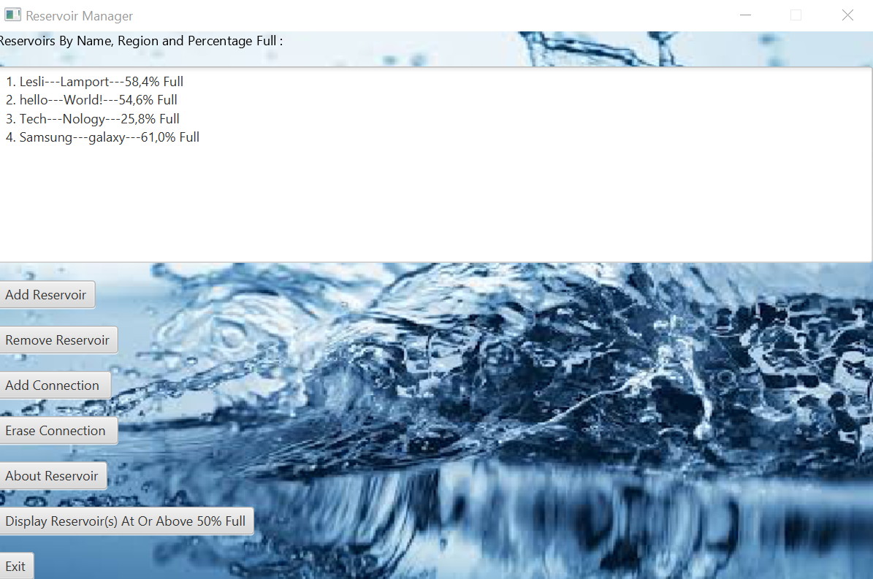
SYSTEM PROCESS SCREENSHOTS
Reservoir Manager Interface

Slide 8
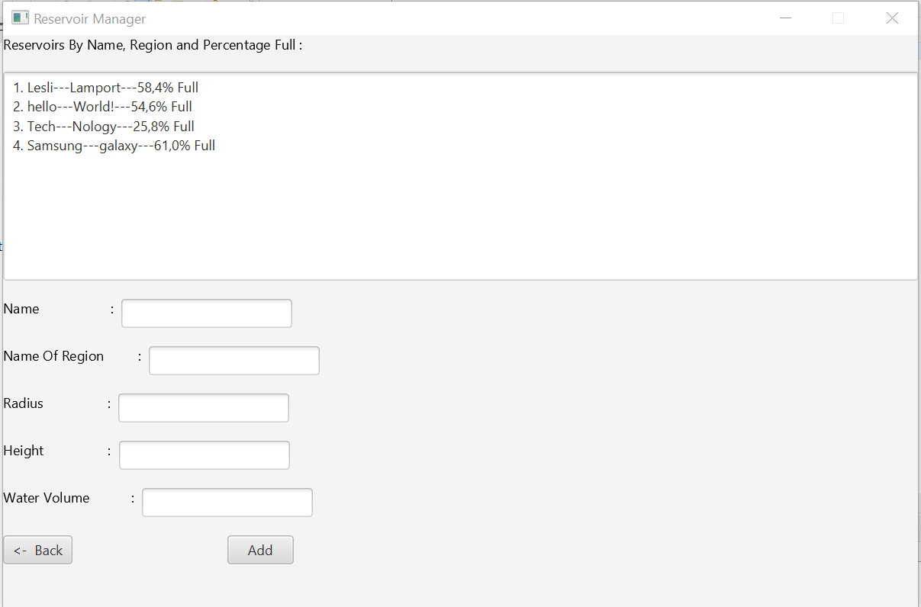
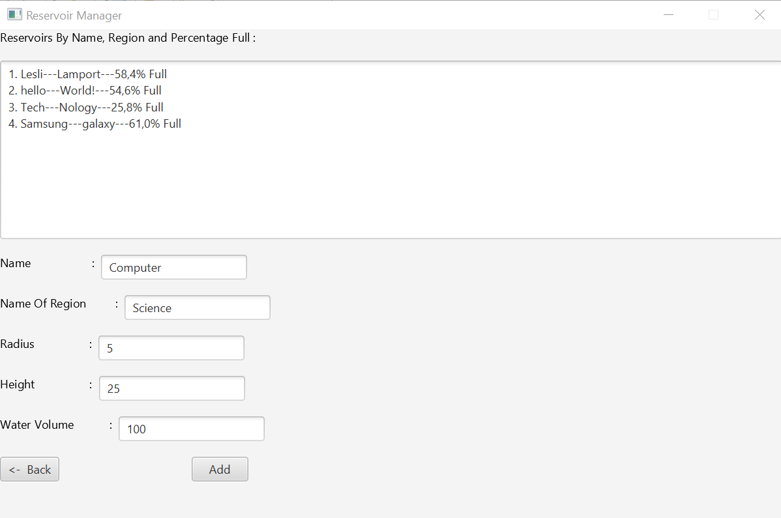

Slide 9
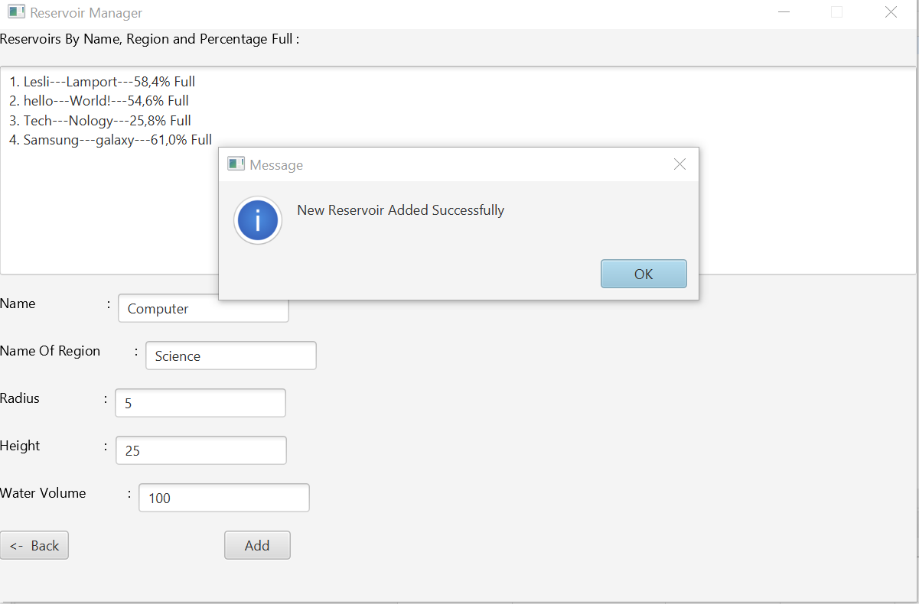
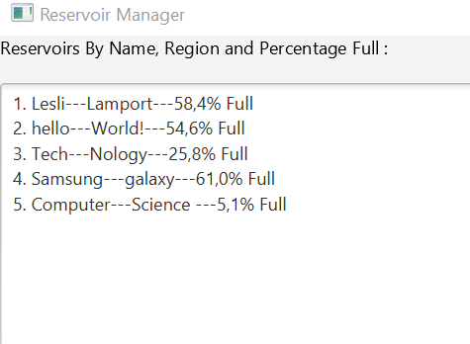
Updated database

Slide 10
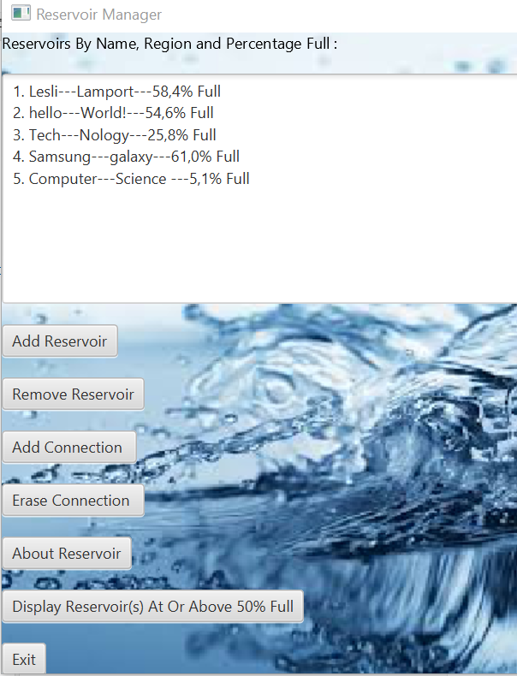
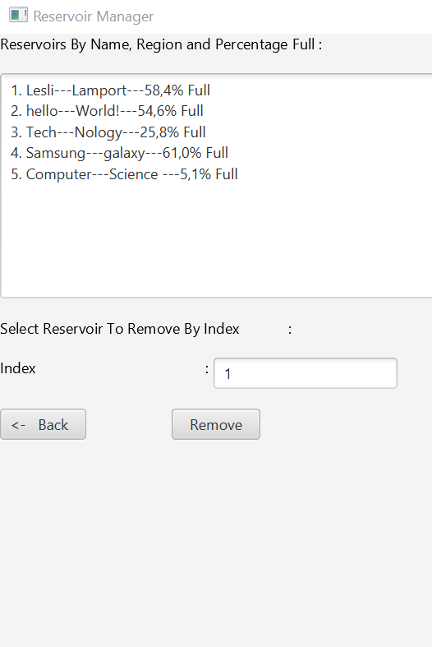

Slide 11
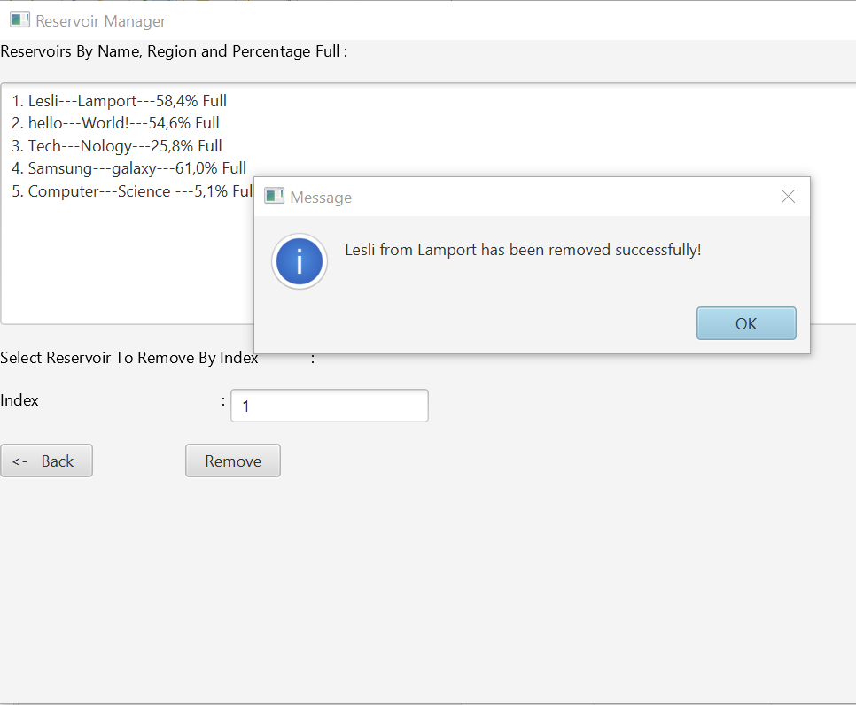
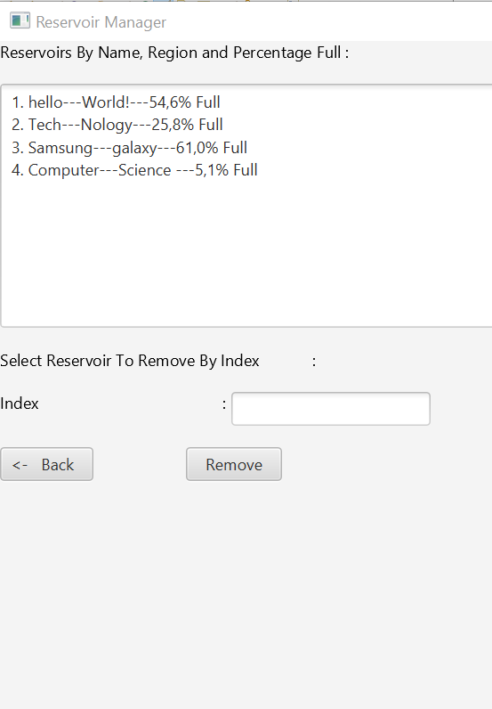

Slide 12
